Slide 1
CO-2 data analysis
Bortolotti Simone, Franzè Lorenzo, Stancioi Ioana-Ruxandra

Slide 2
Content
Task and dataset
Preliminary analysis
BAS analysis and model selection
Models (JAGS)
Clustering
Conclusions

Slide 3
Task and dataset
Section 1

Slide 4

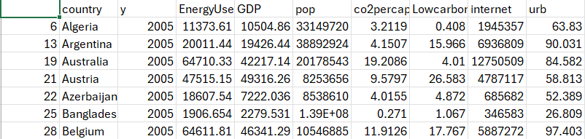
Task and dataset
Explain the CO2 emissions with other variables
Analysis of the relation between GDP and CO2
(checking whether the richer we are, the more CO2 we emit)

Slide 5
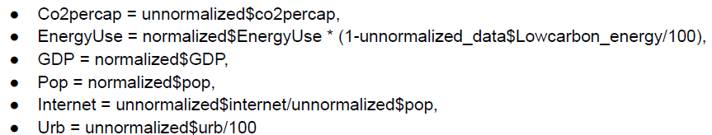
Preliminary analysis - Normalization
Per capita perspective

Slide 6
Preliminary analysis
Section 2

Slide 7
Preliminary analysis - Normalization
High difference in scale and distribution
ZScore
MinMax

Slide 8
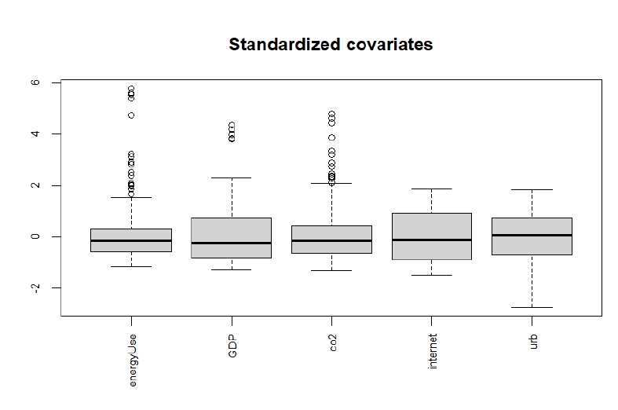
Preliminary analysis - Covariates

Slide 9
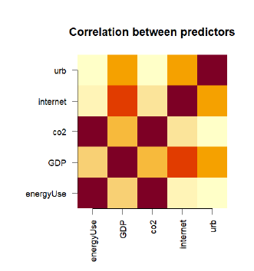
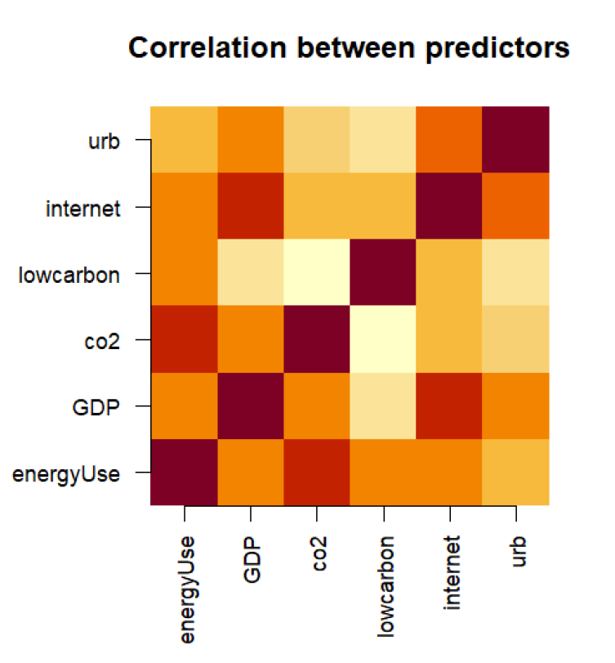
Preliminary analysis - Correlation matrix

Slide 10
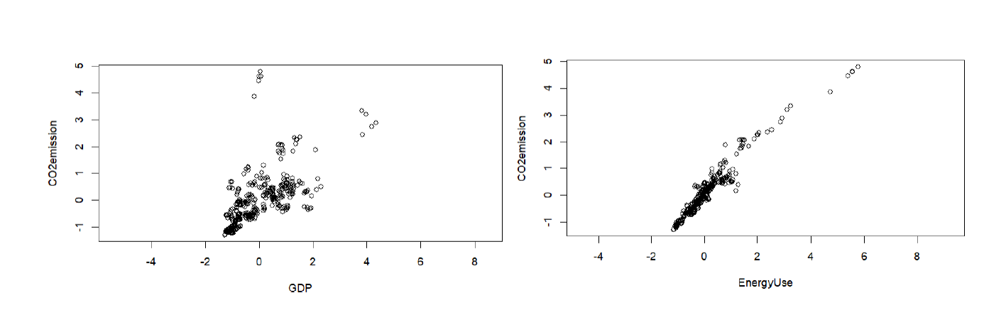
Preliminary analysis - GDP & EnergyUse

Slide 11
BAS analysis and feature selection
Section 3

Slide 12
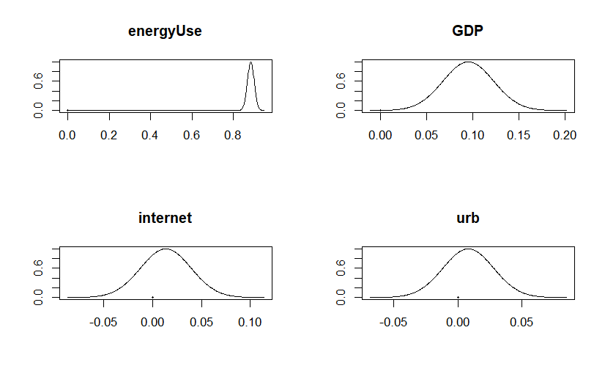
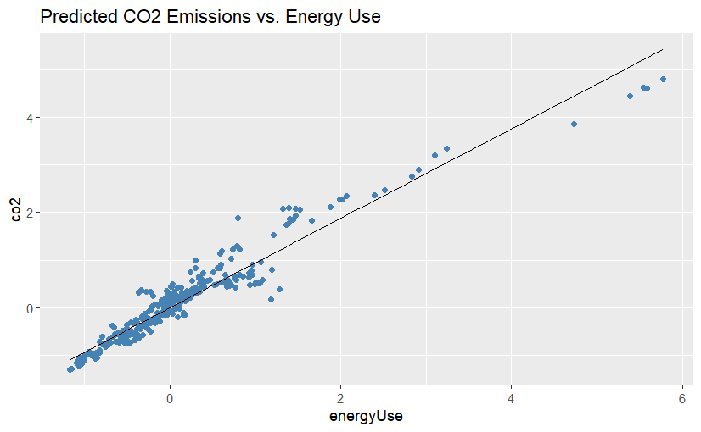
Before considering more complex models
Split in train and test
prediction using only energyUse
g-prior | alpha = n
[1] "Train Mean sum of squared error is: 0.0666247331734019"
[1] "Test Mean sum of squared error is: 0.0591558419947747"
prediction using all the covariates
g-prior | alpha = n
[1] "Train Mean sum of squared error is: 0.0576266600005661"
[1] "Test Mean sum of squared error is: 0.0543753086310353"

Slide 13
P(B != 0 | Y) model 1 model 2 model 3 model 4 model 5
Intercept 1.000 1.000 1.000 1.000 1.000 1.000
energyUse 1.000 1.000 1.000 1.000 1.000 1.000
GDP 0.998 1.000 1.000 1.000 0.000 1.000
internet 0.029 0.000 1.000 0.000 1.000 1.000
urb 0.026 0.000 0.000 1.000 0.000 1.000
BF NA 1.000 0.028 0.027 0.002 0.001
PostProbs NA 0.946 0.026 0.025 0.002 0.001
R2 NA 0.943 0.943 0.943 0.940 0.943
dim NA 3.000 4.000 4.000 3.000 5.000
logmarg NA 405.047 401.471 401.423 398.607 397.930
Marginal Posterior Summaries of Coefficients:
Using HPM
Based on the top 1 models
post mean post SD post p(B != 0)
Intercept 0.02865 0.01416 1.00000
energyUse 0.88544 0.01624 1.00000
GDP 0.11161 0.01678 0.99841
internet 0.00000 0.00000 0.02884
urb 0.00000 0.00000 0.02607
Jeffreys-Zellner-Siow (JZS) priors
prior="JZS" | alpha=1
Showing results only for HPM
[1] "Intercept" "energyUse" "GDP"
[1] "Train Mean sum of squared error is: 0.0577376077419626"
[1] "Test Mean sum of squared error is: 0.0541967365249909"
Features selection
Showing results only for HPM
we decided not to use a BMA since we are interested in the best model and not in the average of the models

Slide 14
P(B != 0 | Y) model 1 model 2 model 3 model 4 model 5
Intercept 1.000 1.000 1.000 1.000 1.000 1.000
energyUse 1.000 1.000 1.000 1.000 1.000 1.000
GDP 0.438 0.000 1.000 0.000 1.000 0.000
internet 0.045 0.000 0.000 1.000 0.000 0.000
urb 0.037 0.000 0.000 0.000 1.000 0.000
energyUse2 1.000 1.000 1.000 1.000 1.000 1.000
GDP2 0.035 0.000 0.000 0.000 0.000 1.000
BF NA 1.000 0.781 0.060 0.045 0.040
PostProbs NA 0.499 0.390 0.030 0.022 0.020
R2 NA 0.948 0.949 0.948 0.949 0.948
dim NA 3.000 4.000 4.000 5.000 4.000
logmarg NA 417.241 416.993 414.426 414.138 414.021
Marginal Posterior Summaries of Coefficients:
Using HPM
Based on the top 1 models
post mean post SD post p(B != 0)
Intercept 0.028655 0.013570 1.000000
energyUse 1.078736 0.020586 1.000000
GDP 0.000000 0.000000 0.437515
internet 0.000000 0.000000 0.044818
urb 0.000000 0.000000 0.036636
energyUse2 -0.046170 0.005378 0.999997
GDP2 0.000000 0.000000 0.035117
[1] "Intercept" "energyUse" "energyUse2"
[1] "Train Mean sum of squared error is: 0.0530340808788469"
[1] "Test Mean sum of squared error is: 0.0431591495882435"
Adding more covariates
non-linear relationships
GDP^2 and energyUse^2
Feature selection
Jeffreys-Zellner-Siow (JZS) priors
prior="JZS" | alpha=1
Showing results only for HPM
[1] "Intercept" "energyUse" "GDP"
[1] "Train Mean sum of squared error is: 0.0577376077419626"
[1] "Test Mean sum of squared error is: 0.0541967365249909"

Slide 15
Conclusion of regression with BAS
If we avoid adding more covariates, the model with the JZS prior has the best performance and among the selected the one with only energyUse and GDP as covariates is the best. It has a lower BIC compared to the other subset of models. The model doesn't overfit on the test set and has a good performance. Lastly it shows a strong relashionship between co2 and GDP since the posterior probability is close to 1.
If instead we add more covariates we can see that the model with the squared of energyUse and energy has a lower BIC compared to the other subset of models and get better overall performances. In this case the importance of GDP with co2 decays.

Slide 16
Models (JAGS)
Section 4.0 - 4.1

Slide 17
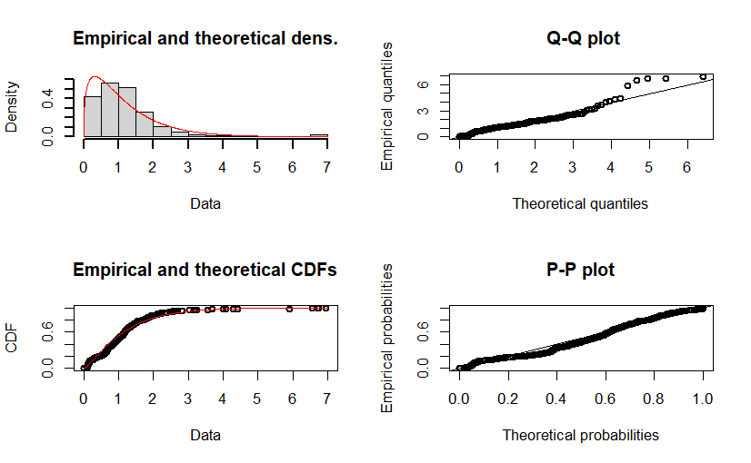
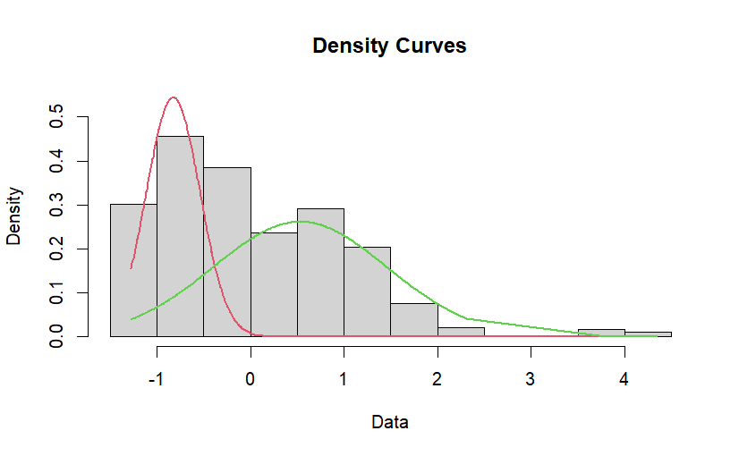
This part was only a trial
Study in deep the distribution of the covariates
Add this information into the model to see if the prediction improves
Get the distribution shape (keeping in mind variables have been standardized and it doesn’t reflect the true distribution)
EnergyUse GDP

Slide 18
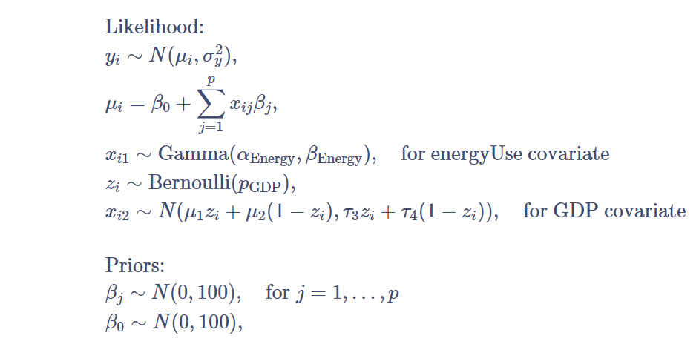
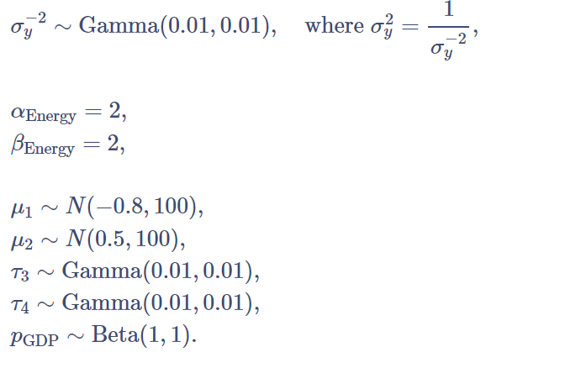
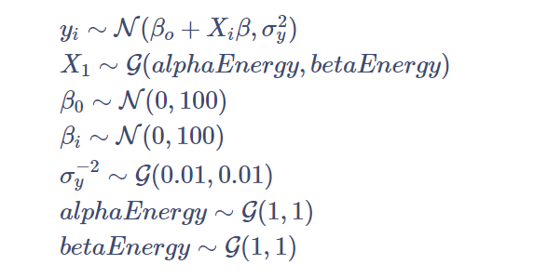
JAGS model considering covariate distribution energyUse and GDP
JAGS model considering covariate distribution energyUse
Mean SD Naive SE Time-series SE
beta[1] 0.90737 0.015500 0.0001790 0.0003201
beta[2] 0.08868 0.024702 0.0002852 0.0005059
beta[3] 0.01345 0.023294 0.0002690 0.0004602
beta[4] 0.01030 0.017080 0.0001972 0.0002306
beta0 -1.05835 0.022125 0.0002555 0.0004334
mu1 -0.83426 0.051364 0.0005931 0.0019826
mu2 0.51722 0.101250 0.0011691 0.0031127
pGDP 0.38227 0.052767 0.0006093 0.0019452
var.y 0.05769 0.004278 0.0000494 0.0000493
2. Quantiles for each variable:
2.5% 25% 50% 75% 97.5%
beta[1] 0.87672 0.896838 0.90732 0.91766 0.93752
beta[2] 0.04132 0.071764 0.08839 0.10520 0.13775
beta[3] -0.03286 -0.002063 0.01378 0.02894 0.05911
beta[4] -0.02324 -0.001317 0.01024 0.02186 0.04405
beta0 -1.10182 -1.073324 -1.05842 -1.04350 -1.01585
mu1 -0.94126 -0.868485 -0.83167 -0.79826 -0.73958
mu2 0.32106 0.448521 0.51691 0.58484 0.71749
pGDP 0.27716 0.345979 0.38372 0.42015 0.48108
var.y 0.04990 0.054692 0.05748 0.06043 0.06678
Mean SD Naive SE Time-series SE
alphaEnergy 1.35769 0.091352 1.055e-03 2.081e-03
beta[1] 0.90722 0.015266 1.763e-04 2.942e-04
beta[2] 0.08923 0.024638 2.845e-04 5.072e-04
beta[3] 0.01262 0.023156 2.674e-04 4.540e-04
beta[4] 0.01061 0.017120 1.977e-04 2.286e-04
beta0 -1.05792 0.021904 2.529e-04 4.091e-04
betaEnergy 1.16403 0.093768 1.083e-03 2.114e-03
var.y 0.05773 0.004384 5.062e-05 5.093e-05
2. Quantiles for each variable:
2.5% 25% 50% 75% 97.5%
alphaEnergy 1.18667 1.293468 1.35418 1.41789 1.54281
beta[1] 0.87681 0.897028 0.90730 0.91765 0.93662
beta[2] 0.04128 0.072276 0.08916 0.10571 0.13721
beta[3] -0.03205 -0.002955 0.01253 0.02858 0.05688
beta[4] -0.02246 -0.001153 0.01080 0.02199 0.04451
beta0 -1.10080 -1.072313 -1.05802 -1.04332 -1.01375
betaEnergy 0.98633 1.100396 1.15981 1.22482 1.35676
var.y 0.04979 0.054642 0.05755 0.06053 0.06698

Slide 19
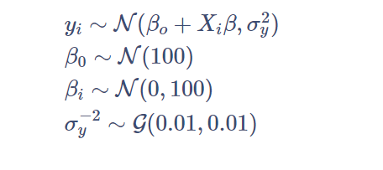
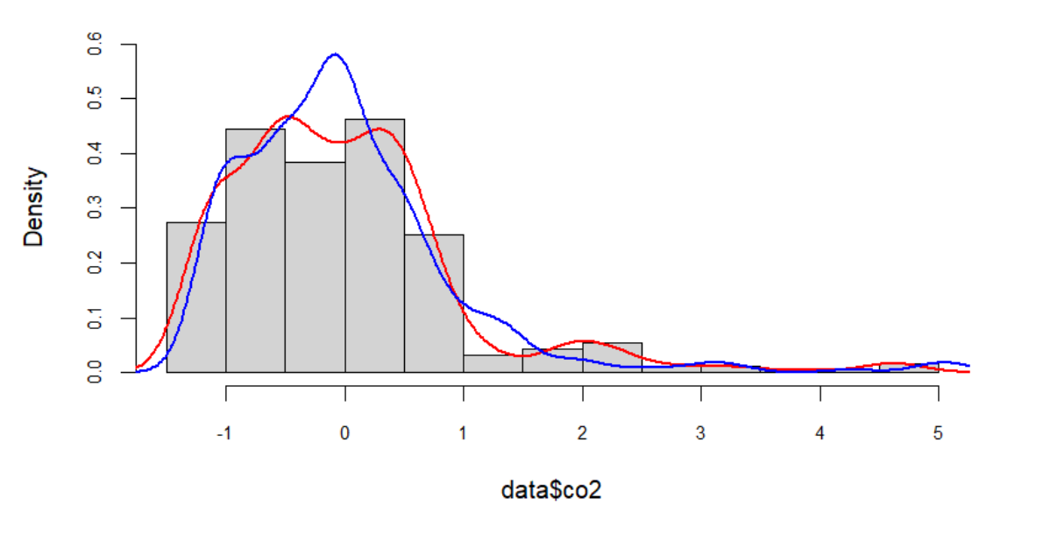
JAGS model no threshold on GDP
Mean SD Naive SE Time-series SE
beta[1] 0.90697 0.015372 1.775e-04 3.116e-04
beta[2] 0.08965 0.024734 2.856e-04 5.249e-04
beta[3] 0.01254 0.023072 2.664e-04 4.495e-04
beta[4] 0.01069 0.016864 1.947e-04 2.284e-04
beta0 -1.05752 0.021857 2.524e-04 4.280e-04
var.y 0.05763 0.004394 5.074e-05 5.074e-05
2. Quantiles for each variable:
2.5% 25% 50% 75% 97.5%
beta[1] 0.87713 0.8966404 0.90687 0.91714 0.93736
beta[2] 0.04167 0.0729711 0.08969 0.10657 0.13861
beta[3] -0.03235 -0.0029236 0.01244 0.02774 0.05806
beta[4] -0.02303 -0.0006827 0.01049 0.02227 0.04367
beta0 -1.10026 -1.0717167 -1.05756 -1.04309 -1.01424
var.y 0.04962 0.0545871 0.05744 0.06042 0.06692
The prediction of previous models doesn't improve but it allowed us to extract the parameters of GDP and energyUse

Slide 20
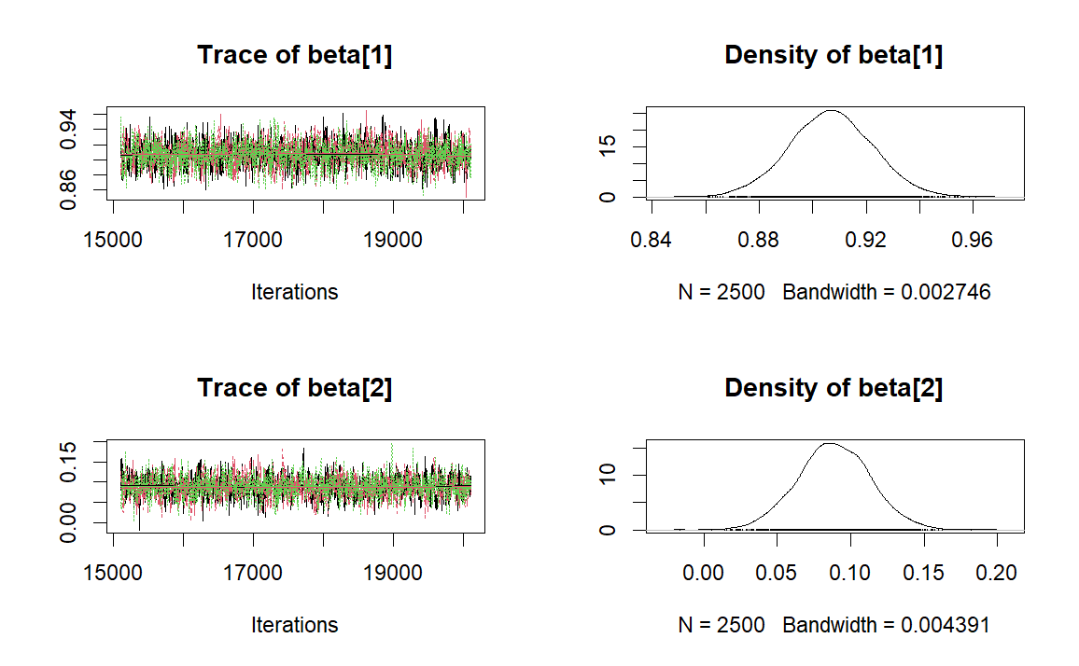
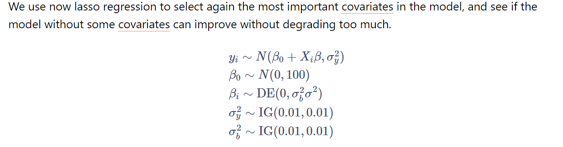
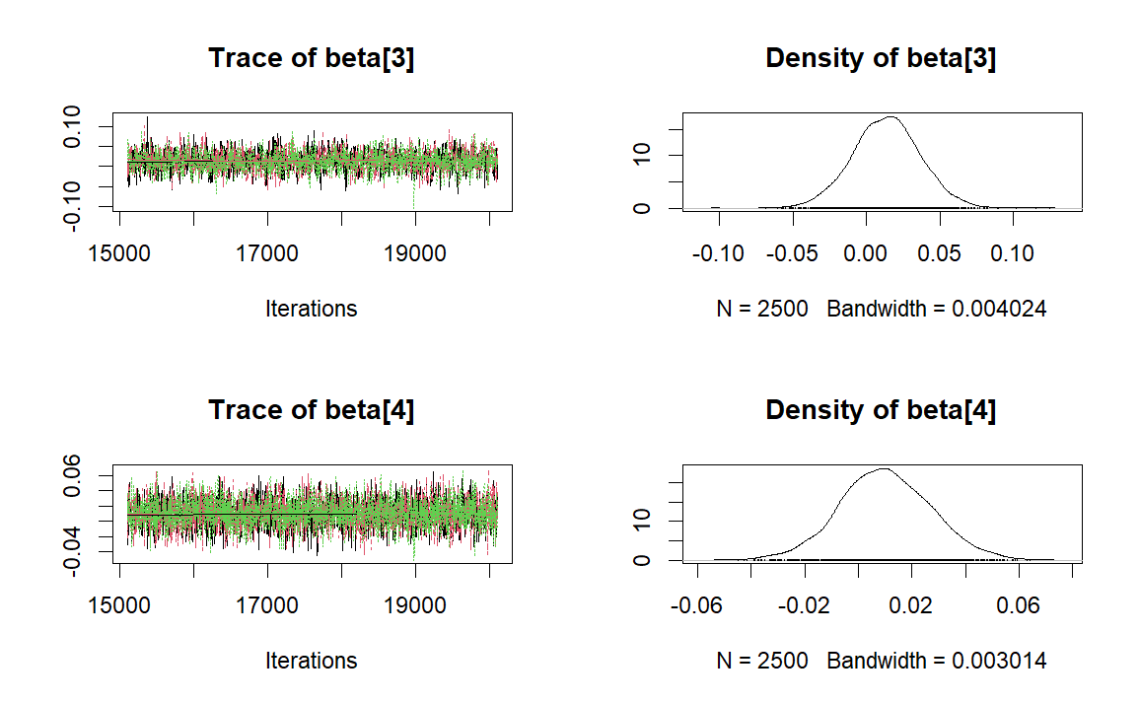
Bayesian LASSO prior
Mean SD Naive SE Time-series SE
beta[1] 0.90688 0.01543 0.0001782 0.0003694
beta[2] 0.08862 0.02468 0.0002849 0.0005653
beta[3] 0.01353 0.02295 0.0002650 0.0005160
beta[4] 0.01014 0.01694 0.0001956 0.0002715
beta0 -1.05745 0.02201 0.0002541 0.0004957
2. Quantiles for each variable:
2.5% 25% 50% 75% 97.5%
beta[1] 0.87623 0.896427 0.906878 0.91717 0.93735
beta[2] 0.03993 0.072306 0.088606 0.10543 0.13740
beta[3] -0.03169 -0.001674 0.013657 0.02863 0.05913
beta[4] -0.02284 -0.001261 0.009799 0.02150 0.04427
beta0 -1.10094 -1.072499 -1.057443 -1.04231 -1.01483

Slide 21
Threshold
Section 4.2.1

Slide 22
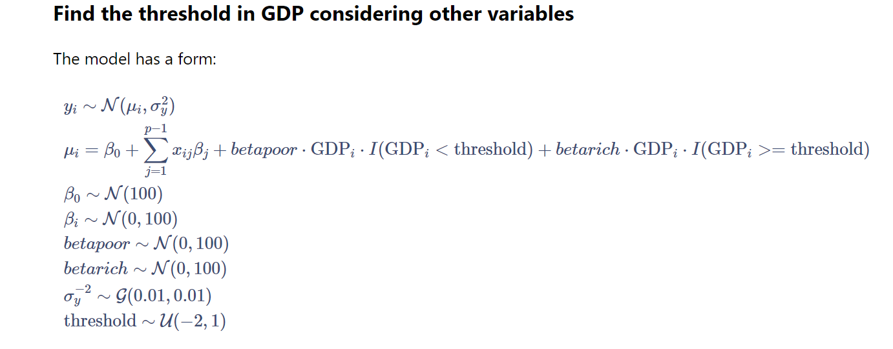
For this analysis different models have been deployed

Slide 23
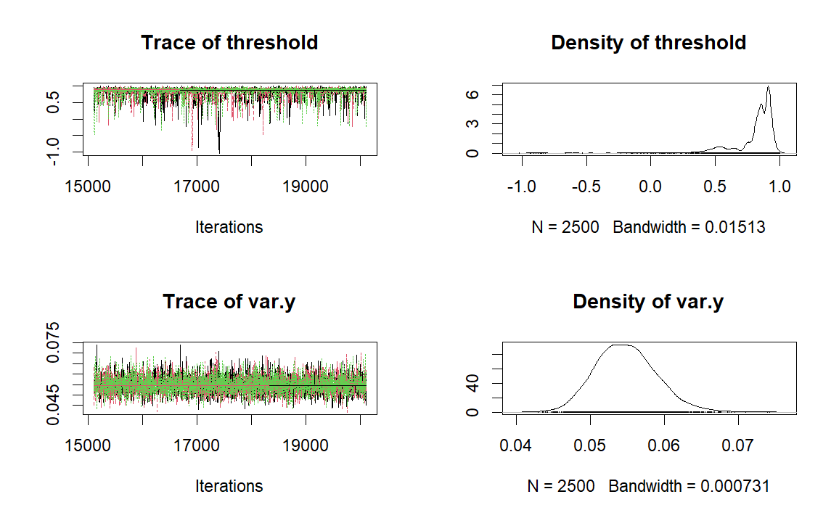
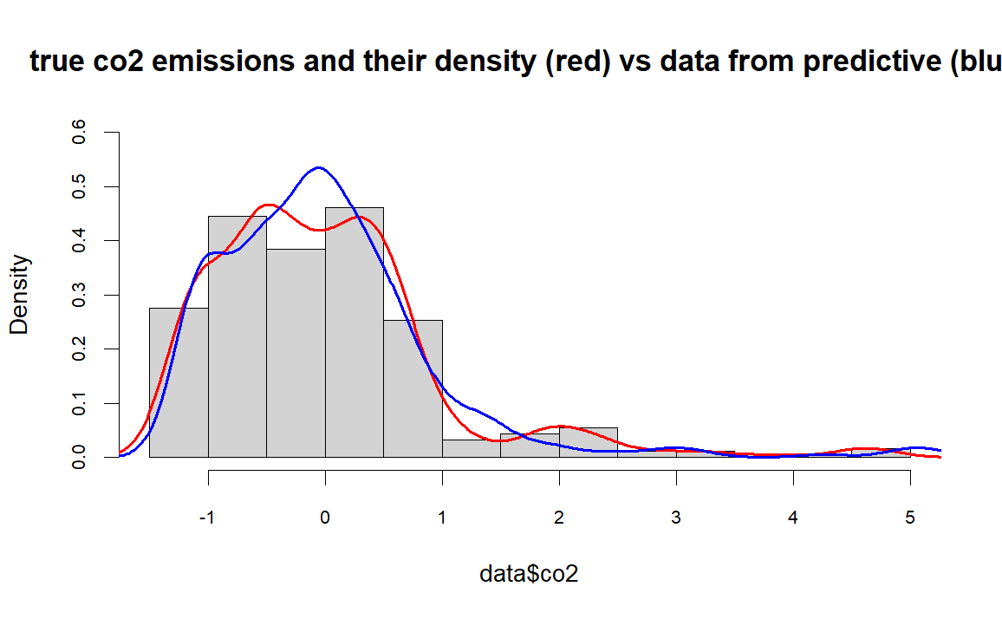
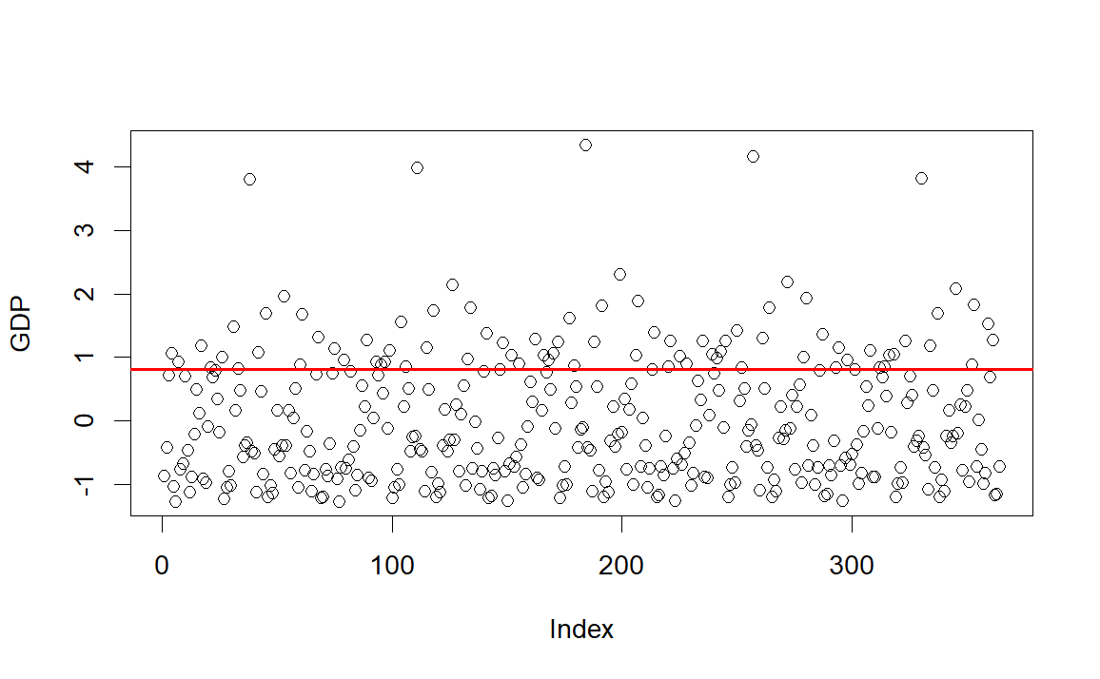
Mean SD Naive SE Time-series SE
beta[1] 0.89524 0.015315 1.768e-04 3.484e-04
beta[2] -0.03050 0.025109 2.899e-04 5.835e-04
beta[3] -0.00564 0.017090 1.973e-04 2.486e-04
beta0 -0.99153 0.028691 3.313e-04 7.761e-04
beta_poor 0.23855 0.044293 5.114e-04 1.211e-03
beta_rich 0.07283 0.024845 2.869e-04 4.626e-04
threshold 0.80185 0.194603 2.247e-03 5.389e-03
var.y 0.05478 0.004112 4.748e-05 5.029e-05
2. Quantiles for each variable:
2.5% 25% 50% 75% 97.5%
beta[1] 0.86507 0.88506 0.895469 0.905597 0.92454
beta[2] -0.07941 -0.04786 -0.030390 -0.013649 0.01849
beta[3] -0.03925 -0.01729 -0.005745 0.006217 0.02823
beta0 -1.04490 -1.01105 -0.993111 -0.973394 -0.93136
beta_poor 0.15322 0.20885 0.237844 0.267334 0.32775
beta_rich 0.02456 0.05594 0.073168 0.089727 0.12164
threshold 0.32895 0.79624 0.859569 0.910171 0.95570
var.y 0.04734 0.05190 0.054606 0.057402 0.06348

Slide 24
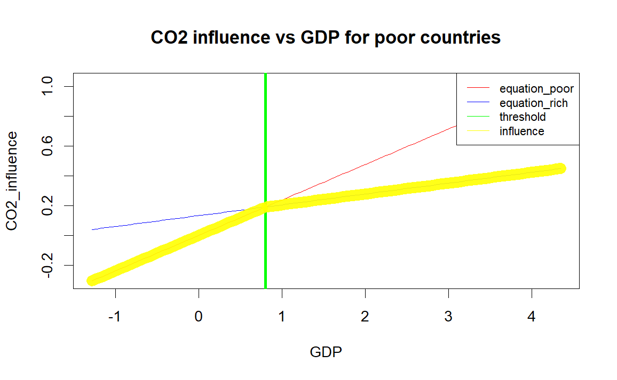
The coefficient beta_poor for poor countries is higher than the coefficient beta_rich for rich countries. This means that the relationship between CO2 emissions and GDP is stronger for poor countries than for rich countries.
However because of all the parameters that are free we think this model is too general and the threshold refers for countries with very high GDP (40000 )
In this we use a single intercept: the assumption is the baseline CO2 emissions level (intercept) is the same across all GDP levels, but the rate of change (slope) with respect to GDP changes at the threshold. Instead all the intercepts are summarized in the first parameter

Slide 25
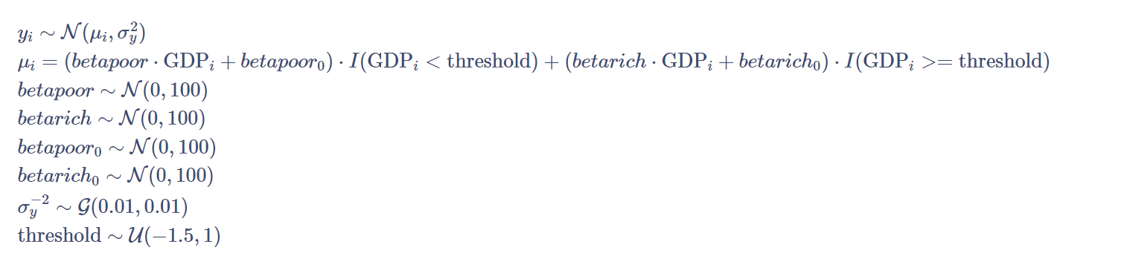
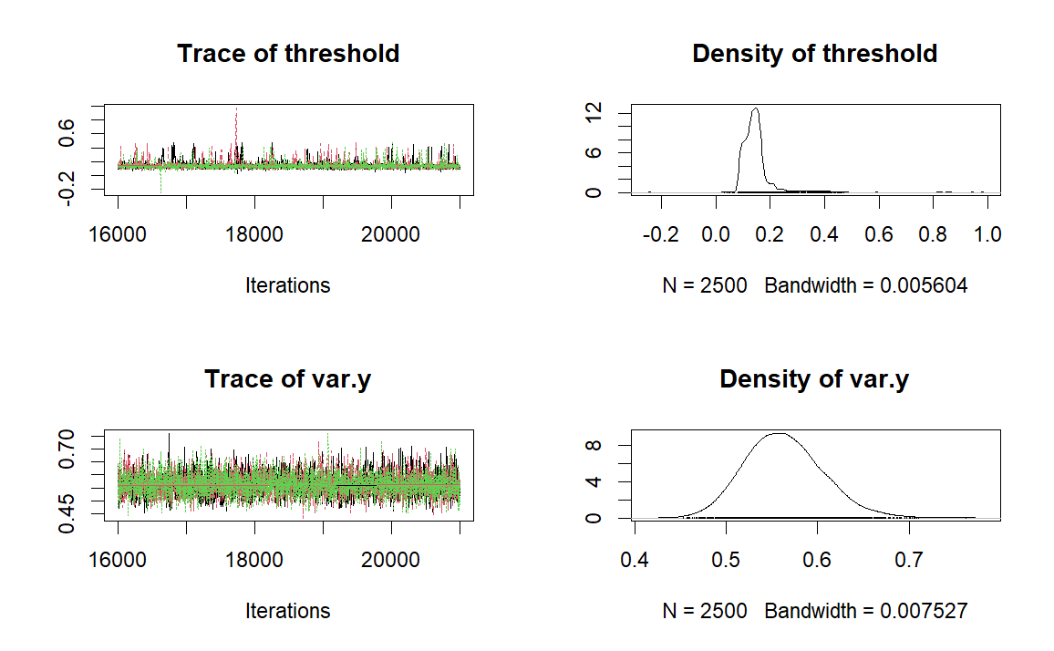
Find the threshold in GDP considering only GDP
Mean SD Naive SE Time-series SE
beta_poor 1.41552 0.14797 0.0017086 0.003881
beta_poor_0 0.58793 0.11624 0.0013422 0.002984
beta_rich 0.53322 0.08458 0.0009766 0.001601
beta_rich_0 0.01984 0.10842 0.0012519 0.002093
threshold 0.14651 0.05753 0.0006643 0.001518
var.y 0.56299 0.04235 0.0004890 0.000489
2. Quantiles for each variable:
2.5% 25% 50% 75% 97.5%
beta_poor 1.11997 1.31635 1.41820 1.5160 1.6991
beta_poor_0 0.35660 0.51157 0.59076 0.6674 0.8118
beta_rich 0.36989 0.47665 0.53184 0.5893 0.7027
beta_rich_0 -0.20049 -0.04954 0.02132 0.0933 0.2267
threshold 0.08693 0.11585 0.13877 0.1581 0.3309
var.y 0.48722 0.53313 0.56090 0.5898 0.6537

Slide 26
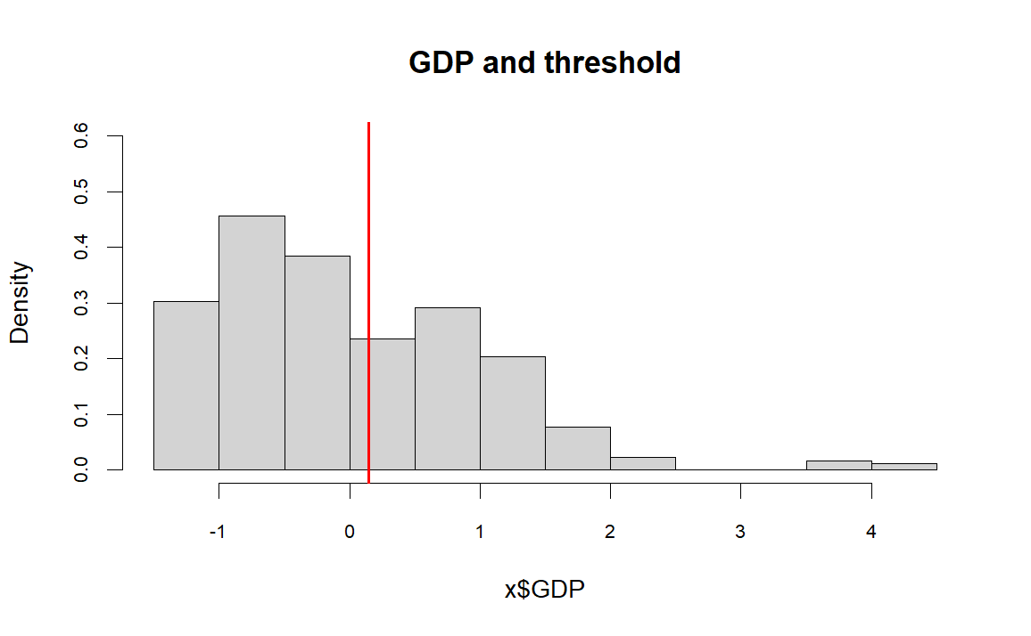
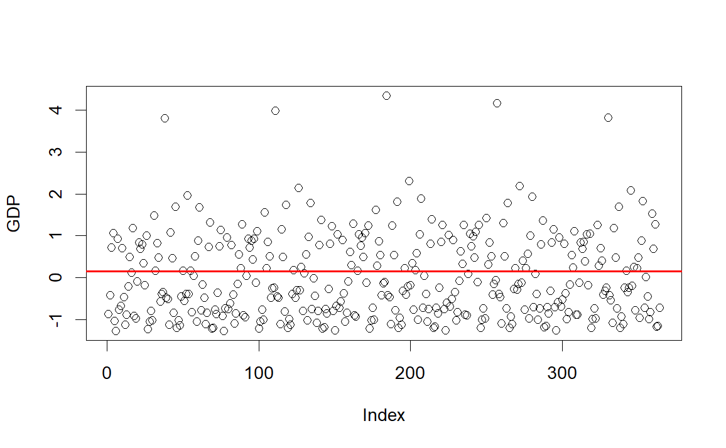
This model is more robust threshold at 30000 (standardized variables)

Slide 27
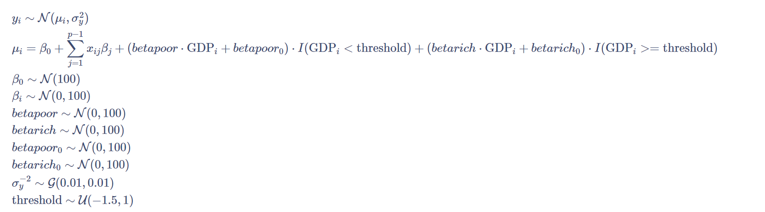
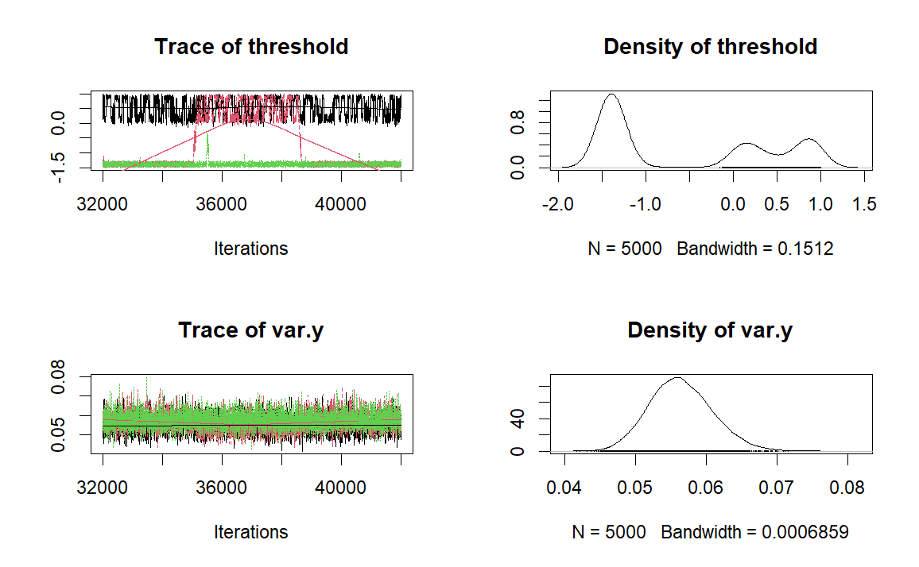
Threshold with different intercepts - Unstable
Mean SD Naive SE Time-series SE
beta[1] 0.902602 0.016226 1.325e-04 3.037e-04
beta[2] -0.008552 0.034486 2.816e-04 2.376e-03
beta[3] 0.003648 0.018780 1.533e-04 5.034e-04
beta0 -2.017844 1.212530 9.900e-03 1.380e-01
beta_poor -0.006683 7.514279 6.135e-02 6.063e-02
beta_poor_0 0.492876 7.327803 5.983e-02 1.181e-01
beta_rich 0.071660 0.038503 3.144e-04 1.310e-03
beta_rich_0 1.010556 1.218549 9.949e-03 1.245e-01
threshold -0.528305 0.975763 7.967e-03 1.471e-01
var.y 0.056470 0.004435 3.621e-05 7.808e-05
2. Quantiles for each variable:
2.5% 25% 50% 75% 97.5%
beta[1] 0.87124 0.891503 0.902701 0.91368 0.93448
beta[2] -0.07634 -0.033781 -0.005914 0.01701 0.05251
beta[3] -0.03301 -0.009233 0.003680 0.01625 0.04005
beta0 -4.51276 -3.152240 -1.477989 -1.10852 -0.35529
beta_poor -17.40161 -1.182368 0.222070 0.85561 17.11251
beta_poor_0 -16.75105 -0.877324 0.581135 2.68696 16.51105
beta_rich -0.01222 0.047735 0.076237 0.09879 0.13790
beta_rich_0 -0.70674 0.099705 0.499394 2.13322 3.45284
threshold -1.48994 -1.400170 -1.296270 0.40722 0.92799
var.y 0.04834 0.053384 0.056238 0.05932 0.06562

Slide 28
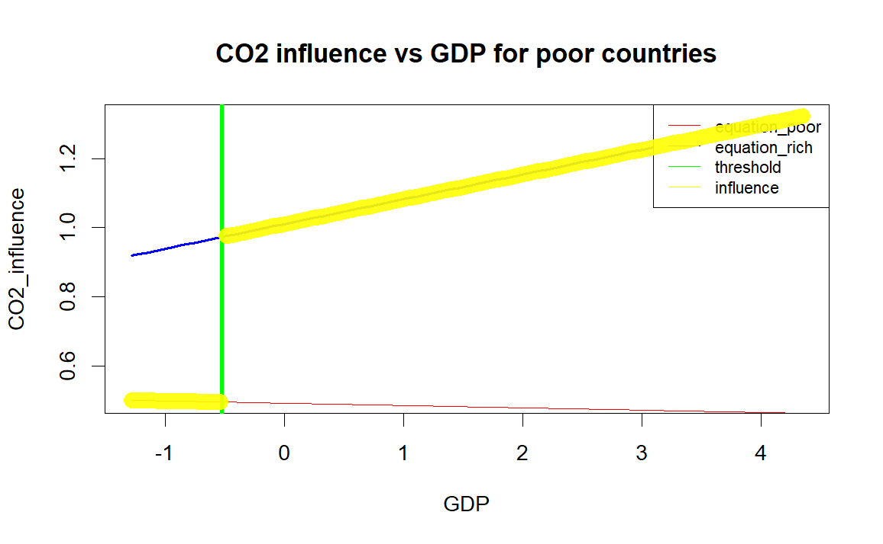
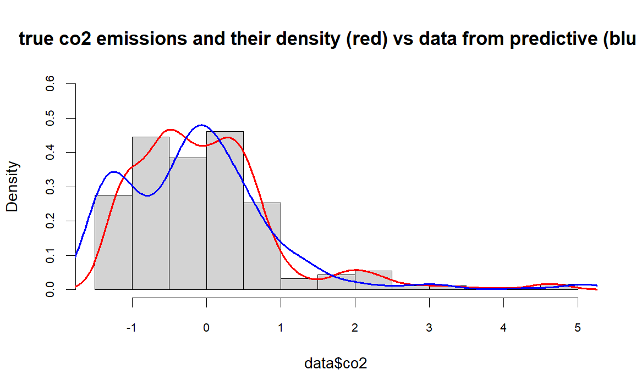
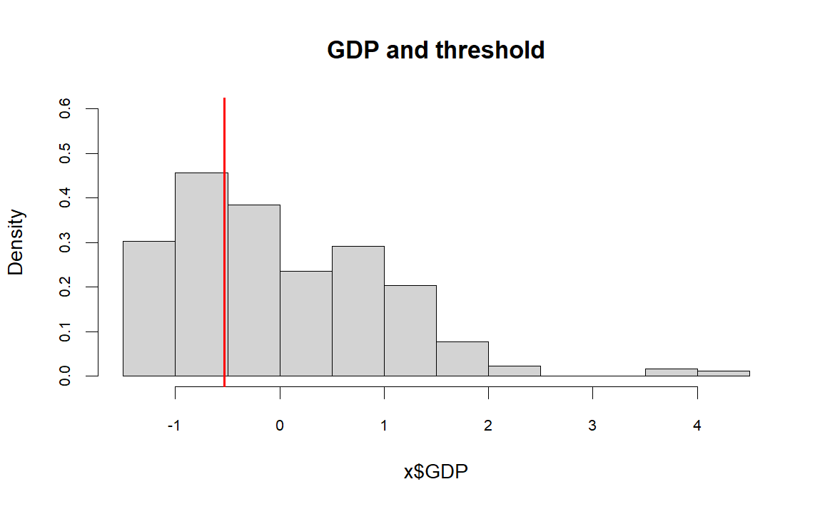
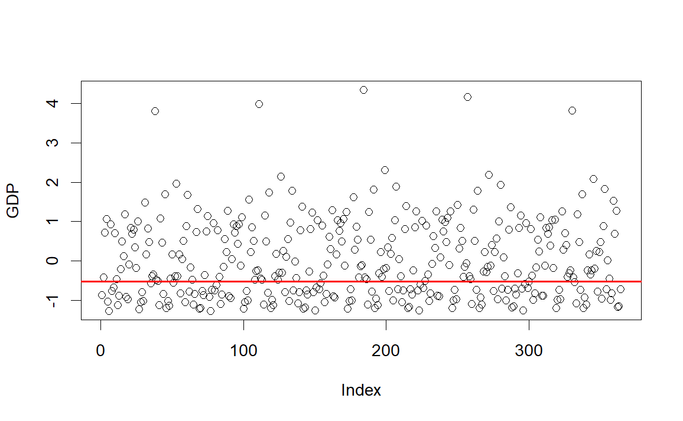

Slide 29
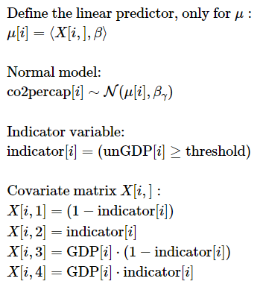
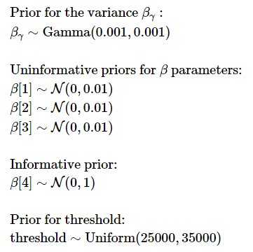
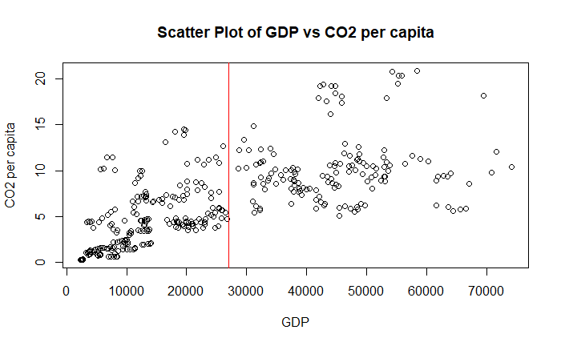
Section 4.2.1: Threshold
To answer the thesis of a threshold in the GDP above which the GDP does not influence the CO2 production we start by putting a uniform prior on the threshold.
The threshold has been found around 27000. This will have to be confirmed by a broader model.
Notes:
To answer the thesis of a threshold in the GDP above which the GDP does not influence the CO2 production we start by putting a uniform prior on the threshold. Several trials have shown that putting a prior on the threshold creates oscillating results if we keep all covariates, therefore a simple normal model using just the GDP covariate and an intercept for both the group above and under the threshold has been created, with a uniform prior between 25000 and 35000 on the threshold and uninformative prior for the covariates, to fix the threshold.
The threshold has been found around 27000.
It is noticeable how the two groups have a number of elements that is comparable, this is needed if we want to have a certain degree of accuracy in the analysis of both groups.

Slide 30
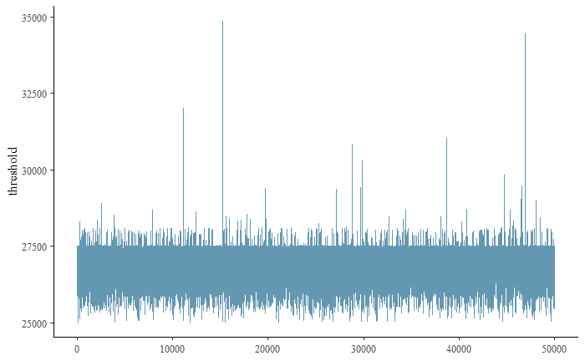
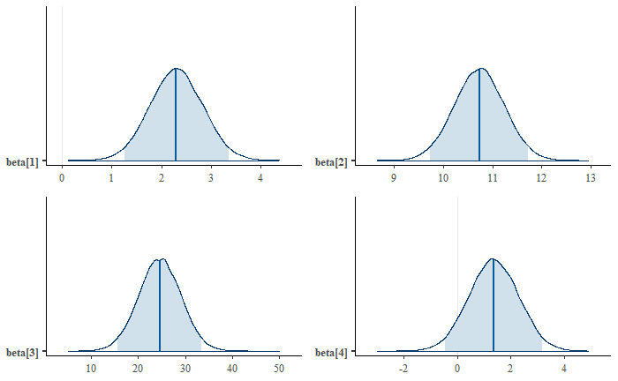
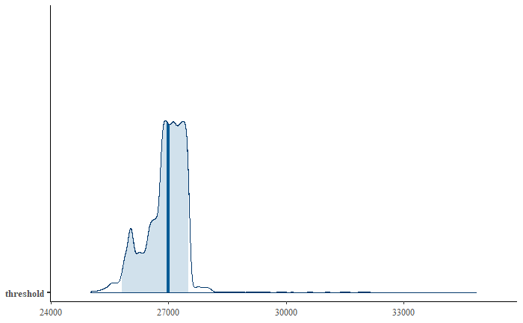
Section 4.2.1: Threshold
Threshold 97.5% credible interval: 25800-27510
Notes:
This simplified model is the one where our thesis seems to be more confirmed, with a posterior distribution average of the parameter related to GDP for Low-GDP countries of around 20, which drops to around 1 for High-GDP countries. The intercept in turn gets from around 2 to 10 to incorporate the saturated GDP-related production.
We can also notice the distribution of the threshold, which is peaked near 27000, it has not a bell shape, but we don’t have to forget we have few points around the threshold in our dataset, therefore it could be fluctuating around those. Anyway, there is no point in not fixing the threshold, since it would change group to few points adding more complexity.
This will have to be confirmed by a broader model.

Slide 31
Normal model with threshold
Section 4.2.2
Notes:
It should be noticed we separated the two dataset completely, without assuming that the other covariates would have remained the same below and above the threshold. We did this since we noticed how in our more general model this was already the case, without the need of assuming it. This is a stronger way of demonstrating our thesis, since we don’t need to leave out a level of complexity to let emerge the difference in the GDP parameter below and above.
Indeed if we used the assumption of a single parameter for the remaining covariate in the two groups, we could have missed how another covariate was explaining better the variance in the observation with respect to the GDP parameter, making the difference in the GDP parameter near zero.

Slide 32
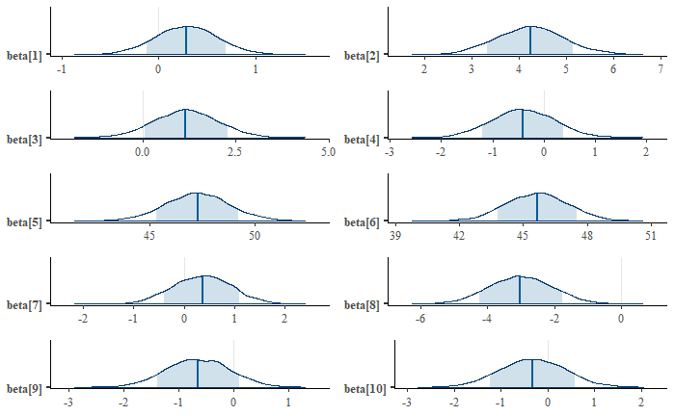
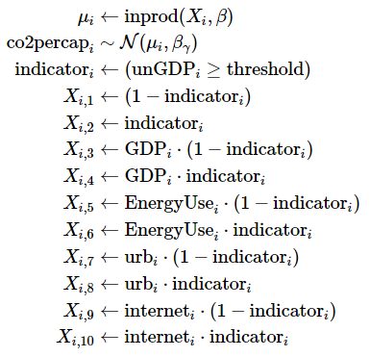
Section 4.2.2: Normal model with threshold
We now add all more relevant covariates in a Normal model, keeping a flat prior, to find out if our thesis hold.
Notes:
This model is built with uninformative flat priors, using the threshold of 27000 to separate in two groups the high-GDP and low-GDP countries. The observations are modelled using a simple normal model, where only the mean is influenced by the 4 covariates (even though urbanization and internet level did not belong to the best selected model, we tried several options and we included them in the model, to show how their results differ from the covariates that are mode useful).
The results partially confirm our initial thesis: the parameter associated to the GDP of low-GDP countries shows a direct proportionality to the CO2 per capita, while the relation is near zero for the high-GDP group, even though the zero value is included also in the 95% credible region of the parameter associated to the GDP of low-GDP countries (in the picture the 80% credible region is used, to keep outside the zero axis and show that it is still improbable that the covariate is irrelevant).
It is also visible how EnergyUse is by far the covariate that explains the largest part of the variability in the dataset, indeed it is more than an order of magnitude bigger than the others (this is relevant since here we used MINMAX normalization) both over and under the threshold (this can be a sign of relevance since all covariates have been normalized).
Regarding the Urbanization and Internet covariate, they are as expected near zero, with the exception of Urbanization over the GDP threshold: this should inversely relate the Urbanization of a high-GDP country with its pollution, this could mean that living in a city could be more efficient from the pollution point of view.
Finally, the Intercept parameter is higher for the countries over the GDP threshold, this was expected by our thesis since it takes on itself the CO2 per capita portion that was explained by the GDP covariate in the data points under the threshold.

Slide 33
Section 4.2.2: Normal model with threshold
It should be noticed we separated the two dataset completely, without assuming that the other covariates would have remained the same below and above the threshold. We did this since we noticed how in our more general model this was already the case, without the need of assuming it. This is a stronger way of demonstrating our thesis, since we don’t need to leave out a level of complexity to let emerge the difference in the GDP parameter below and above.
Indeed, if we used the assumption of a single parameter for the remaining covariate in the two groups, we could have missed how another covariate was explaining better the variance in the observation with respect to the GDP parameter, making the difference in the GDP parameter near zero.
Notes:
This slide is just in case he asks. It should not be brought up if he doesn’t.

Slide 34
Gamma model with threshold
Section 4.2.4

Slide 35
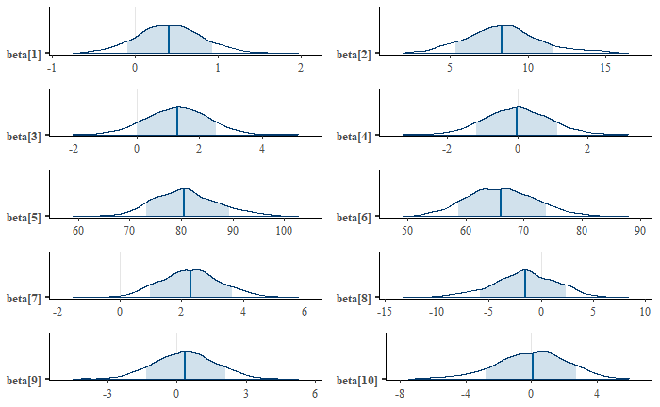
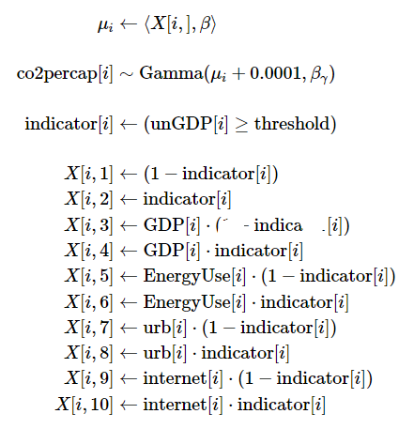
Section 4.2.4: Gamma model with threshold
In order to establish the robustness of the Normal model, we tried also an analogous Gamma model.
Notes:
The only difference between the normal model and this one is that the covariates are used to predict the parameter Shape of a Gamma distribution and not the Mean of a Normal distribution. This model will not be deeply commented, since we just created it to show that the result are the same in considering the Normal model. Indeed even if the Normal and Gamma distribtutions are different, the behaviour of the distribution changes similarly if we change the first parameter of the two, at least in the needed range.
We therefore just see how the parameters regarding the Intercept, the EnergyUse and the GDP have a clearly similar behaviour, with the Intercept going up in magnitude, the GDP losing relevance and the EnergyUse keeping an elevated value in both cases.

Slide 36
Time series model
Section 4.3

Slide 37
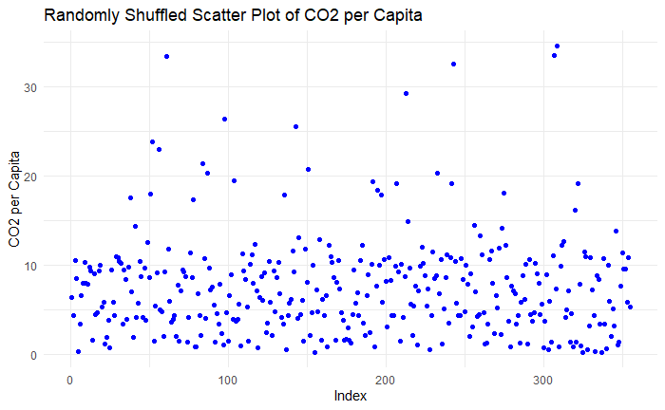
Section 4.3: Time series model
Let’s consider a Bayesian AR(1) model, where the current observation in the series is based on the immediately preceding observation, adjusted by a stochastic term. We insert also the main covariates.
The resulting time series have much more stable trajectory, demonstrating the potentially great effectiveness of this data organization in the case of this dataset.
Notes:
Let’s consider a Bayesian AR(1) model, where the current observation in the series is based on the immediately preceding observation, adjusted by a stochastic term. We insert also the main covariates. We insert the main covariates to check their relevance against the AutoRegressive term, to find out what the final model gives more importance with the parameters to get an accurate prediction.
We stop at AR(1) since we have series of only 5 data points, where only 3 of them refer to a non-crisis period.
The resulting time series we obtain separating the dataset in the temporal series for each country have much more stable trajectory, demonstrating the potentially great effectiveness of this data organization in the case of this dataset. It’s noticeable how these lines have lower slopes and no peaks, they are definitely easier to explain than the initial group of observations.
The AR(1) model advantage is that these time series seems to have a baseline each, probably influenced by many complex factors, but by having the last observation we can have an idea of what the baseline is with no further data.

Slide 38
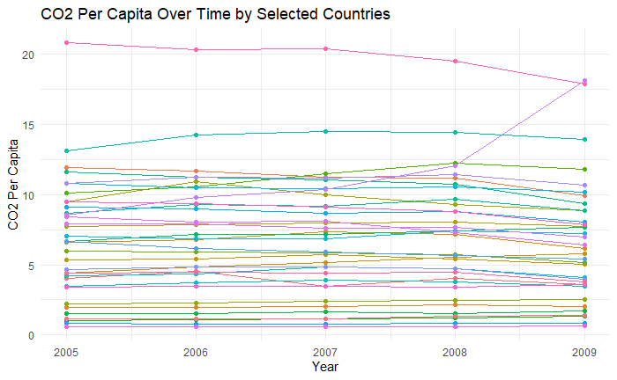
Section 4.3: Time series model
Let’s consider a Bayesian AR(1) model, where the current observation in the series is based on the immediately preceding observation, adjusted by a stochastic term. We insert also the main covariates.
The resulting time series have much more stable trajectory, demonstrating the potentially great effectiveness of this data organization in the case of this dataset.
Notes:
Let’s consider a Bayesian AR(1) model, where the current observation in the series is based on the immediately preceding observation, adjusted by a stochastic term. We insert also the main covariates. We insert the main covariates to check their relevance against the AutoRegressive term, to find out what the final model gives more importance with the parameters to get an accurate prediction.
We stop at AR(1) since we have series of only 5 data points, where only 3 of them refer to a non-crisis period.
The resulting time series we obtain separating the dataset in the temporal series for each country have much more stable trajectory, demonstrating the potentially great effectiveness of this data organization in the case of this dataset. It’s noticeable how these lines have lower slopes and no peaks, they are definitely easier to explain than the initial group of observations.
The AR(1) model advantage is that these time series seems to have a baseline each, probably influenced by many complex factors, but by having the last observation we can have an idea of what the baseline is with no further data.

Slide 39
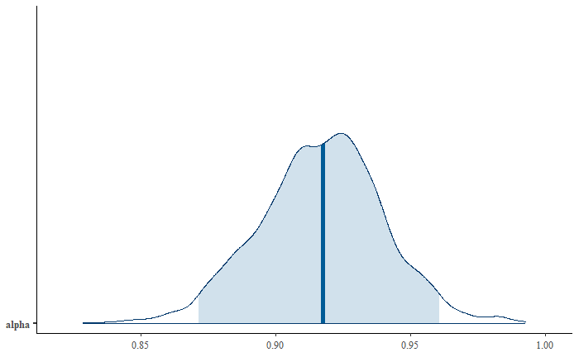
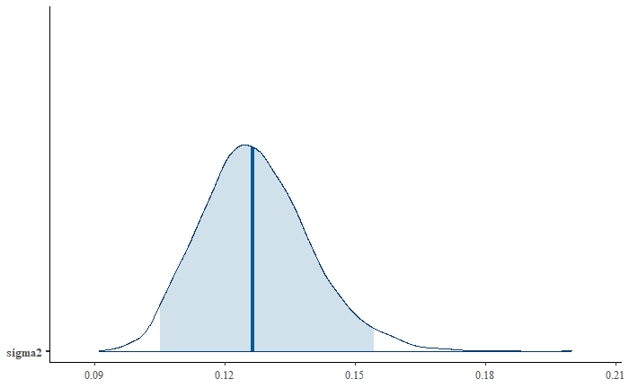
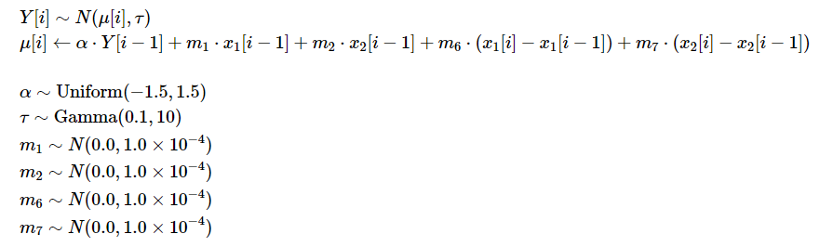
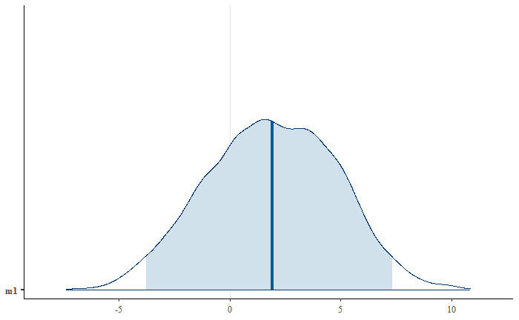
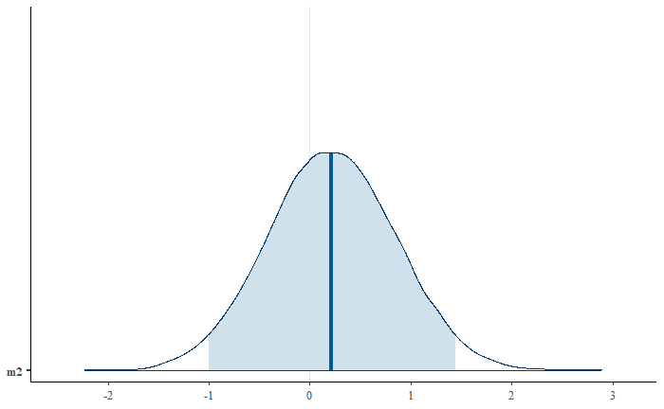


Section 4.3: Time series model
The structure is composed by a Normal model, where the mean is a linear combination of the covariates and flat priors for the parameters.
Previous CO2 per capita Y[i-1]: previous year observation.
EnergyUse x1[i-1]: previous year total energy consumption.
EnergyUse-difference x1[i]-x1[i-1]: change in energy consumption from previous year.
GDP x2[i-1]: previous year GDP.
GDP-difference x2[i]-x2[i-1]: change in GDP from previous year.
Notes:
Using the difference is the same as using the current year covariate alone, since the model is linear, but for interpretability reason we favour this structure.
The model shows how the last observation contributes with more than 90% of its original value to the prediction, with the covariate representing the difference between the EnergyUse of the current and the past year, called m6, which is the only one that has not the zero axis in its 95% credible interval.

Slide 40












Section 4.3: Time series model
Two subset of data were examinated according to the time period: pre crisis and during the economic crisis.
2005-2007
2007-2009
We assumed that more variability could be present when the economic crisis happened, this was in a way confirmed by the data.
Notes:
We assumed that more variability could be present when the economic crisis happened. The first model uses period 2005-2006 to predict 2006-2007, while the second uses 2007-2008 to predict 2008-2009.
Alpha has a lower standard deviation in the first period, since it sees data from a period where the situation was more stable and the prediction of the year before was more useful.
Sigma2 is lower in the first period, since the mean of the predicted observation is predicted in a more accurate way when the crisis is not present.
Both m1, m6 (which are the parameters related to the energy use) have a higher variance in the "crisis period" and the importance of the difference in energy use decreases a lot.
Instead m7 increases in relevance during the crisis, but it has a variance which is extremely high, with a credible region which comprehends 0. This possibly derives by the fact that in the crisis period the GDP-difference is somewhat used to understand how much the crisis impacted.

Slide 41



Section 4.3: Time series model
The following are the In-sample and Out-of-sample prediction of the first model (period 2005-2008 used to predict year 2008-2009), we noticed for all combinations of data used in the model and in the prediction a small MSE, which brought to a satisfactory prediction.
Notes:
Even if the data contribute to create 2 somewhat different models with respect to the periods 2005-2007 and 2007-2009, the fact that the time series are long only 5 data points and the fact that the co2percapita of a nation is usually a stable value, means that the prediction results to be satisfactory even with few points, also using just the period 2005-2006 to predict the period 2006-2009.

Slide 42



Section 4.3: Time series model
Two subset of data were examinated according to the GDP: Low-GDP countries and High-GDP countries.
For both cases the results are indeed more accurate than with all data together, this could mean that the two groups present different characteristics, but not more complexity. In particular the Highest-GDP group has the highest accuracy.
Notes:
Trying to separate the richest and poorest countries, the results are indeed more accurate than with all data together, it was also visible that the difficulties in predicting the crisis period data are still present. This difficulties could be increased by the small number of data points, unable to explain the variability in a context where a switchpoint, several covariates and a threshold are present.
Both accuracy found trying to predict only a portion of the countries is actually higher than the accuracy we had using all datapoints, even if this happens without any parameter changing its sign or its magnitude. This could mean that the two groups present different characteristics and in particular since the High-GDP groups present the highest accuracy, we could think there is less variability in the general CO2 per capita value once the threshold is reached (even if the GDP and GDP-difference parameter by themselves are not far from zero).

Slide 43
Clustering
Section 5

Slide 44


Section 5: Clustering
One-dimension mixture model, CO2 per capita clustered in 3 Normal curves.
The resulting clusters have mean 1.25, 7.24 and 18.87. The largest is the the middle one (82%) containing most variability, followed by the first one of the less polluting countries (13%), finally the third group contains some “super-polluters” (5%).
Notes:
Clustering can be an effective way to find some hidden regularities and correlation in the data. We carried out three levels of analysis, with 1, 2, 3 different covariates at the same time, but the only significant results came out in the first two levels.
At first we considered a 1-dimension model, looking at the covariates separately, we were able to obtain some results, but they were already visible in a way from the plot. In particular the CO2 per capita values were best separated in 3 clusters, of different value and number of points: the first group contained the most variability, it accounted for almost one seventh of the data points and contained the group of lowest polluting countries, with a mean of 1.25. The middle-polluting countries group was instead way more concentrated at a mean level of 7.24 and it contained more than four countries out of fifth. The remaining group was the heaviest-polluting, containing only around 5% of the countries, with a mean of 18.87, almost three times the middle group. The large difference in the values observed between the top polluters (like Canada, Australia and the USA) and the average group confirms the idea that a small percentage of the world population is responsible for a more relevant percentage of the pollution.

Slide 45

Section 5: Clustering
One-dimension mixture model, CO2 per capita clustered in 3 Normal curves.
The resulting clusters have mean 1.25, 7.24 and 18.87. The largest is the the middle one (82%) containing most variability, followed by the first one of the less polluting countries (13%), finally the third group contains some “super-polluters” (5%).
Notes:
Clustering can be an effective way to find some hidden regularities and correlation in the data. We carried out three levels of analysis, with 1, 2, 3 different covariates at the same time, but the only significant results came out in the first two levels.
At first we considered a 1-dimension model, looking at the covariates separately, we were able to obtain some results, but they were already visible in a way from the plot. In particular the CO2 per capita values were best separated in 3 clusters, of different value and number of points: the first group contained the most variability, it accounted for almost one seventh of the data points and contained the group of lowest polluting countries, with a mean of 1.25. The middle-polluting countries group was instead way more concentrated at a mean level of 7.24 and it contained more than four countries out of fifth. The remaining group was the heaviest-polluting, containing only around 5% of the countries, with a mean of 18.87, almost three times the middle group. The large difference in the values observed between the top polluters (like Canada, Australia and the USA) and the average group confirms the idea that a small percentage of the world population is responsible for a more relevant percentage of the pollution.

Slide 46


Section 5: Clustering
Two-dimension mixture model, CO2 per capita clustered in 2 Normal bivariate curves.
The two groups found have average GDP around 23000 and 40000, with the first group accounting for more than three times the point in the second group. The second group is also responsible for an average CO2 per capita production of 12.5, way higher than the 5.5 of the first group.
Notes:
The 2-dimensional model correlating CO2 per capita and GDP is more meaningful, in particular the two groups found have average GDP around 23000 and 40000, with the first group accounting for more than three times the point in the second group. The second group is also responsible for an average CO2 per capita production of 12.5, way higher than the 5.5 of the first group.

Slide 47

Section 5: Clustering
Two-dimension mixture model, CO2 per capita clustered in 2 Normal bivariate curves.
The two groups found have average GDP around 23000 and 40000, with the first group accounting for more than three times the point in the second group. The second group is also responsible for an average CO2 per capita production of 12.5, way higher than the 5.5 of the first group.
Notes:
The 2-dimensional model correlating CO2 per capita and GDP is more meaningful, in particular the two groups found have average GDP around 23000 and 40000, with the first group accounting for more than three times the point in the second group. The second group is also responsible for an average CO2 per capita production of 12.5, way higher than the 5.5 of the first group.
This part actually was done initially as a study of the dataset, we put it here since the actual analysis was more succesfull in findint relationship in our case.

Slide 48
Conclusions
Relationship between CO2 emissions and GDP is non linear.
Strength of autoregression in country-wide CO2 prediction.
Usefulness of EnergyUse with respect to the other covariates

